Slide 1
PUBLIC TRANSPORTATION OPTIMIZATION
ENCHANCING EFFICIENCY AND ACCESSIBILITY
SUBMITTED BY :
P.KARTHIKEYAN
N.UDHAYAKUMAR
K.MOHAMED IMRAN
A.KARUPPASAMY
G.DEVA

Slide 2
Introduction
Welcome to the presentation on “Public Transportation Optimization.”
In today’s rapidly urbanizing world, efficient and sustainable public transportation is more critical than ever.
This presentation will delve into the strategies and technologies used to optimize public transportation systems for the benefits of both cities and commuters

Slide 3
Challenges in Public Transportation
Briefly introduce the topic and its importance in urban planning and sustainability.
State the goal of the presentation: to explore methods for optimizing public transportation.
Edinburgh is making transport more sustainable by increasing their number of electric, hybrid, and lower emissions buses

Slide 4
Benefits of Optimization
Discuss the advantages of Optimization public transportation, including reduced congestion, lower emissions, and enhanced user experience.
Risk mitigation, Mapping activities makes it easier to standardize processes and formalize them.
Cost reduction
Better results
Higher efficiency
Optimized time management
Better over view
Better problem solving capability
Controlled compliance

Slide 5
Optimization Strategies
Present various strategies for improving public transit, such as route optimization, scheduling, and fare integration.
Include real-world example of cities Implementing these strategies.
One cannot simply publish a random collection of pages and posts

Slide 6
Technology Solutions
Highlight the role of technology in public transportation optimization .
As a Technology solution consulting company we can help with many area including strategy enter prize application support all types and phase of custom application development.
Leading edge Technologies such as cloud voice interfaces and iot
our Technology are experts at guiding clients through this process.

Slide 7
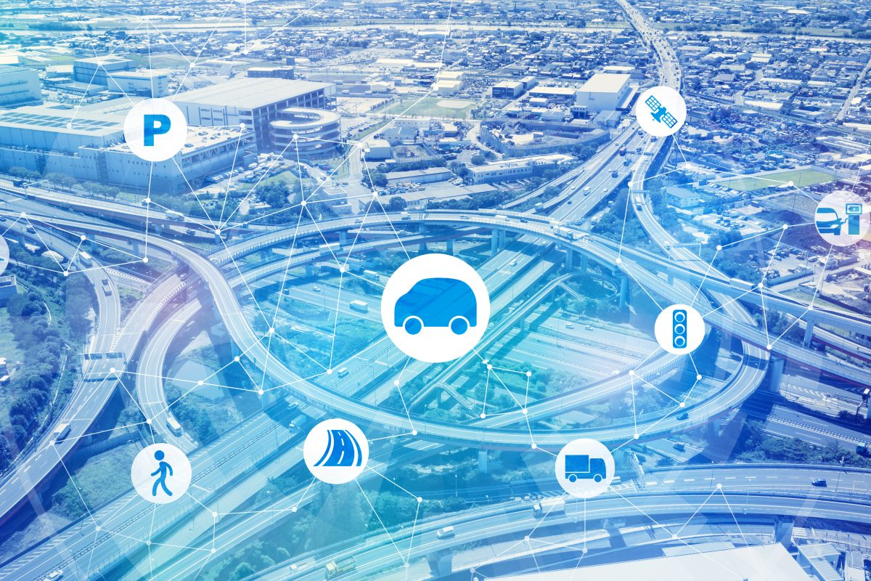
Route and Schedule Optimization
Explain how route optimization algorithms can reduce travel time and improve service coverage.
Discuss dynamic scheduling for real-time adjustments.

Slide 8
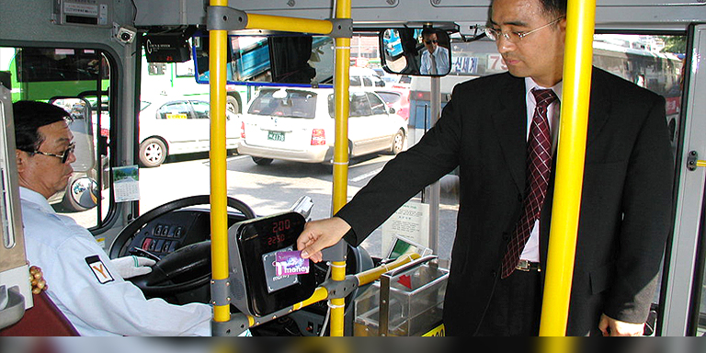
Fare Integration and Payment Systems
Explore the benefits of integrated fare systems, including contactless payments and universal fare cards

Slide 9
Passengers Information Systems
Discuss the importance of providing real-time information to passengers via apps, signage, and online platforms.
Static or schedule information ,which changes only occasionally and is typically used for journey planning prior to departure.
Real time information, derived from automatic vehicle location systems.

Slide 10
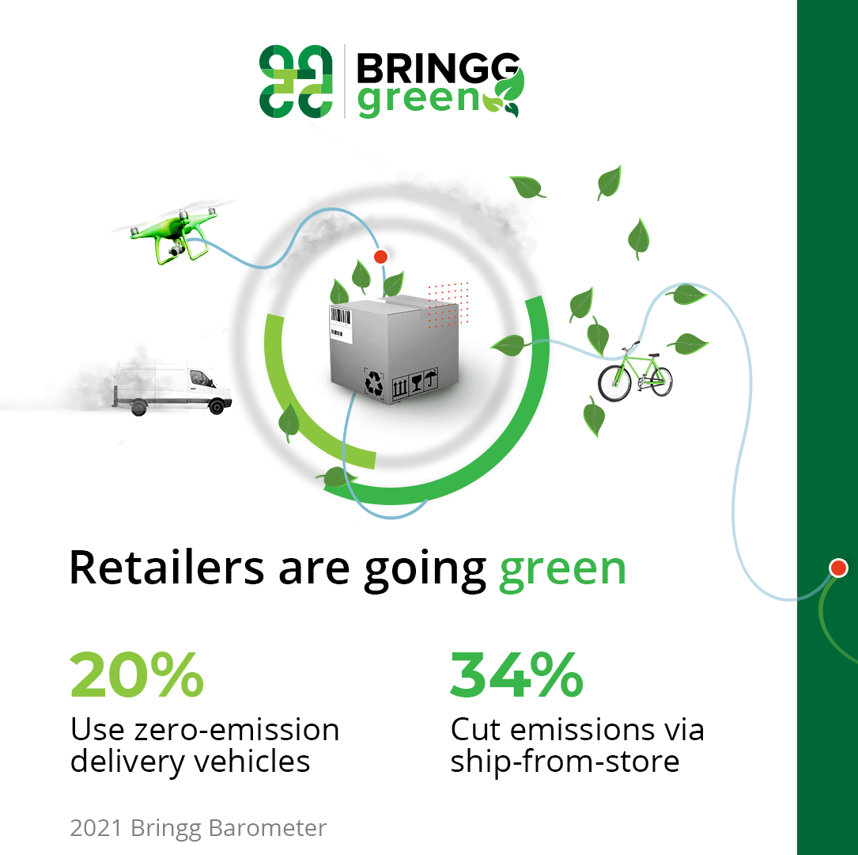
Eco-Friendly Initiatives
Explain how electrification and cleaner fuels can reduce the environmental impact of public transportation.

Slide 11
Case Studies
Showcase successful examples of cities or regions that have optimized their public transportation systems.
Highlight the results achieved through optimization efforts.

Slide 12
Challenges and Considerations
Address potential challenges, such as the cost of implementing new technologies and public resistance to change.
Discuss the role of infrastructure improvements in optimizing transportation, such as dedicated lanes and stations.

Slide 13
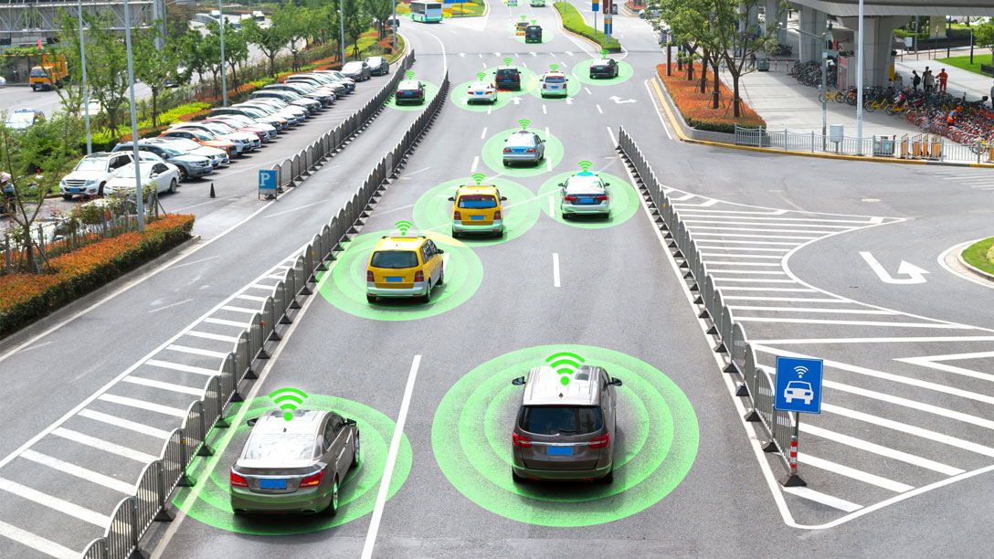
Future Trends
Explore upcoming trends in public transportation optimization, including autonomous vehicles and AI-driven systems.

Slide 14
Conclusion
Summarize key takeaways from the presentation.
Emphasize the importance of continued efforts to optimize public transit for sustainable urban mobility.

Slide 15
Applications
Route and Schedule Planning
Fare Integration
Real-Time Passenger Information
Demand-Responsive Transit (DRT)
Traffic Signal Coordination
Park-and-Ride Facilities
Maintenance Scheduling
Eco-Friendly Initiatives
Adaptive Traffic Management
Multimodal Trip Planning
Emergency Response Planning
Transit-Oriented Development (TOD)
Accessible Transportation
Sustainability Initiatives
Data Analytics
Urban Planning

Slide 16
Advantages
Reduced Congestion
Improved Reliability
Enhanced Accessibility
Cost Savings
Environmental Benefits
Improved User Experience
Integrations and Multimodal Transportation
Data-Driven Decision-Making
Safety and Security
Economic Benefits
Sustainable Urban Development
Reduce Energy Consumption
Social Equity
Improved Transit Operations
Public Health Benefits

Slide 17
Disadvantages
Cost of Implementation
Resistance to Change
Data Privacy Concerns
Technological Dependence
Equity Issues
Limited Coverage
Complex Decision-Making
Inflexibility
Initial Disruptions
Maintenance and Updates
Complexity for Operators
Environmental Concerns
Unforeseen Consequences

Slide 18
THANK
YOU

